Slide 1

DEPARTMENT OF ARTIFICIAL INTELLIGENCE AND DATA SCIENCE
Artificial Neural Networks and Deep Learning: 21ADG64
LA1 - Seminar
Applications of Graph Neural Networks in Social Network Analysis
Presented By
RAHUL N G [1NT21AD040]
Name of the Course Instructor Dr Meenakshi

Slide 2

CONTENTS
Introduction and Motivation
Methodology and Approach
Results and Analysis
Conclusion and Future Recommendations
Demo video of code
Github link of PPT and Code
References

Slide 3
Introduction
GNNs are a class of neural networks designed to perform reasoning on data structured as graphs.
Graph Neural Networks :
They are crucial for modern machine learning tasks that involve relational data, providing a way to leverage the structure and connections within the data.

Slide 4
Motivation
Use of GNNs in SNA
Node Classification:
Link Prediction:
Community Detection:
Graph Classification:

Slide 5
Case Study: Link Prediction
The task of predicting the existence of a link between two nodes in a network.
Crucial for applications like recommending friends in social networks and identifying potential collaborations.
Increase user engagement by suggesting potential new friends, thereby enhancing social connections.

Slide 6
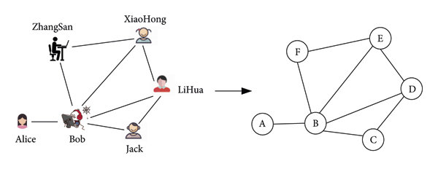
Graph Construction
Nodes: Represent users or entities within the social network.
Edges: Represent interactions or relationships between users (e.g., friendships, follows, messages).
Node Features: Capture relevant attributes of each user (e.g., age, location, interests).
Edge Features: If available, include attributes like interaction frequency, type of interaction, etc.
Implementation of Link Prediction

Slide 7
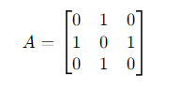
Implementation of Link Prediction
Graph Representation: Adjacency Matrix
An adjacency matrix is a square matrix used to represent a finite graph. The elements of the matrix indicate whether pairs of vertices (nodes) are adjacent or not in the graph.
Steps to Construct:
Initialize the Matrix:
Create an n×n matrix filled with zeros, where n is the number of nodes.
Populate the Matrix:
For each edge between nodes i and j, set A[i][j]=1 and A[j][i]=1
(for an undirected graph).
Example:
Nodes: 1, 2, 3
Edges: (1, 2), (2, 3)
Node 1 is connected to Node 2: 𝐴[0][1]=𝐴[1][0]=1
Node 2 is connected to Node 3: 𝐴[1][2]=𝐴[2][1]=1

Slide 8
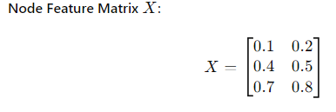
Implementation of Link Prediction
Graph Representation: Node Feature Matrix
A node feature matrix stores additional information about each node in the graph. Each row represents a node, and each column represents a feature.
Steps to Construct:
Identify Features:
Determine the number of features for each node.
Initialize the Matrix:
Create an n×d matrix, where n is the number of nodes and d is the number of features per node.
Populate the Matrix:
Assign feature values to each node.
Example:
Nodes: 1, 2, 3
Features: [feature1, feature2]
Feature Values:
Node 1: [0.1, 0.2]
Node 2: [0.4, 0.5]
Node 3: [0.7, 0.8]

Slide 9
GNN Model Selection:
Objective: Choose an appropriate GNN architecture to learn node embeddings.
Common Architectures:
Graph Convolutional Networks (GCNs): Aggregate information from neighboring nodes.
GraphSAGE: Sample and aggregate information from a fixed number of neighbors.
Graph Attention Networks (GATs): Use attention mechanisms to weigh the importance of neighboring nodes.
Implementation of Link Prediction

Slide 10
Implementation of Link Prediction
Node Embedding Generation
Use the GNN to generate low-dimensional representations (embeddings) for each node in the graph.
Forward Pass: Feed the graph data into the GNN to produce embeddings for each node. These embeddings capture the node's local structure and feature information.
Embedding Output: The GNN outputs a vector for each node, summarizing its position and context within the network.

Slide 11
Formulate Link Prediction
Objective: Use the node embeddings to predict the likelihood of links (edges) between nodes.
Node Pair Selection: Select pairs of nodes between which you want to predict links.
Existing Edges: Known connections in the graph.
Potential Links: Possible connections that are not yet present.
Embedding Combination: Combine the embeddings of the selected node pairs to form a feature vector for each pair. Common combination methods include:
Concatenation: Combine the two embeddings into a single vector.
Element-wise Product: Multiply corresponding elements of the two embeddings.
Distance Metrics: Compute a distance or similarity metric (e.g., dot product, cosine similarity).
Scoring Function: Apply a scoring function to the combined embeddings to estimate the likelihood of a link. This can be a simple similarity measure, or a more complex function learned during training.
Implementation of Link Prediction

Slide 12
Negative Sampling
Objective: Generate negative samples (non-edges) for evaluation purposes.
Negative Samples: Create pairs of nodes that are not connected in the current graph to balance the positive (existing edges) and negative samples for a more accurate assessment of link prediction performance.
Implementation of Link Prediction

Slide 13
Results and Analysis
Prediction: For each node pair, compute the link prediction score using the trained model.
Thresholding: Apply a threshold to the scores to classify pairs as linked or not linked.
Evaluation Metrics: Assess the model's performance using metrics such as
AUC-ROC, precision, recall, and F1-score to measure its accuracy in predicting links.
Objective: Evaluate the model's predictions to assess its performance.

Slide 14
Results and Analysis
Key Considerations
Scalability: Efficiently handling large-scale social media graphs.
Dynamic Nature: Adapting to changes over time in the social network.
Data Privacy: Ensuring the protection of user data and privacy.
Negative Sampling: Ensuring a balanced representation of positive and negative samples for training and evaluation.

Slide 15
Conclusion and Future Recommendations
Link prediction using GNNs in social media offers valuable insights into the evolving dynamics of online communities. By leveraging deep learning techniques, we can uncover hidden patterns and predict future interactions, facilitating personalized user experiences and fostering community engagement.
Explore Potential Integration of Real-time Data Streams: Consider integrating real-time data streams into the GNN framework to adaptively update link predictions and user recommendations, enabling more dynamic and responsive social media platforms.

Slide 16
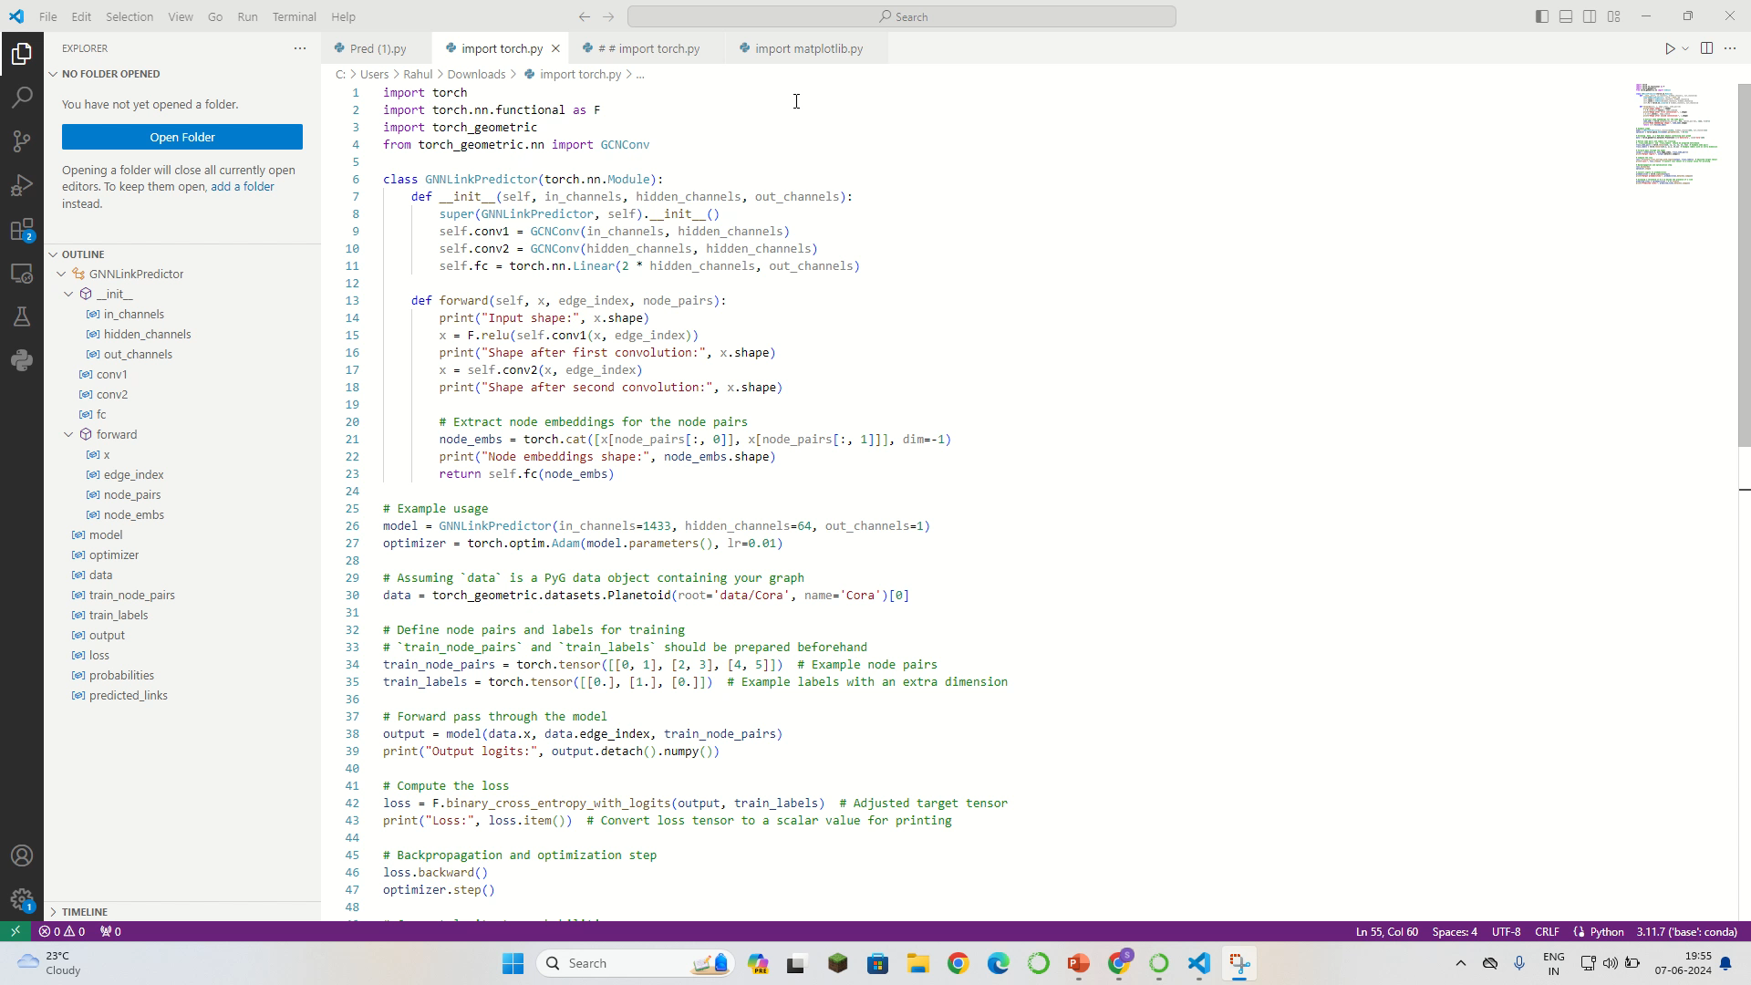
Demo video of code

Slide 17
References
Original GCN Paper:
Kipf, T. N., & Welling, M. (2016). "Semi-Supervised Classification with Graph Convolutional Networks." arXiv preprint arXiv:1609.02907.
Paper Link
Link Prediction Survey:
Martínez, V., Berzal, F., & Cubero, J. C. (2017). "A Survey of Link Prediction in Complex Networks." ACM Computing Surveys (CSUR), 49(4), 69.
Applications of GNNs in Social Networks:
Wu, Z., Pan, S., Chen, F., Long, G., Zhang, C., & Yu, P. S. (2020). "A Comprehensive Survey on Graph Neural Networks." IEEE Transactions on Neural Networks and Learning Systems, 32(1), 4-24.
https://arxiv.org/abs/1901.00596
Privacy in Social Network Analysis:
Zheleva, E., & Getoor, L. (2007). "To Join or Not to Join: The Illusion of Privacy in Social Networks with Mixed Public and Private User Profiles." In Proceedings of the 18th International Conference on World Wide Web (pp. 531-540).

